Slide 1

Spotify Data Analysis using Postgres SQL

Slide 2
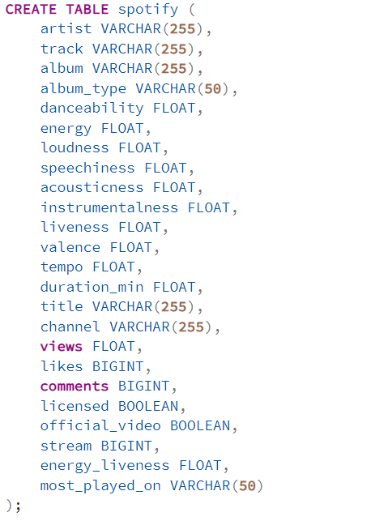
Schemas

Slide 3

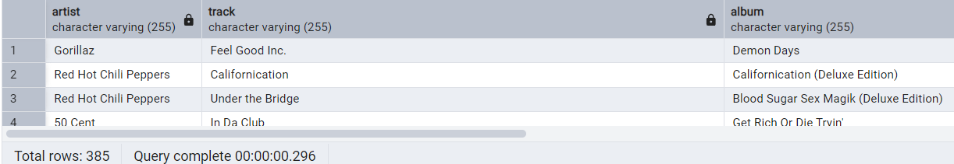
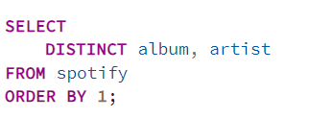
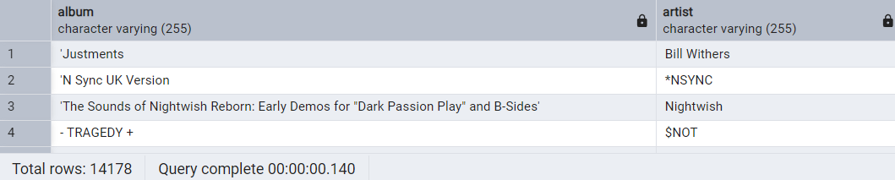
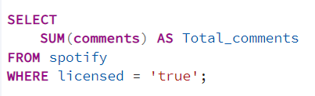

QUERIES
1. Retrieve the names of all tracks that have more than 1 billion streams.
2. List all albums along with their respective artists.
3. List all albums along with their respective artists.

Slide 4
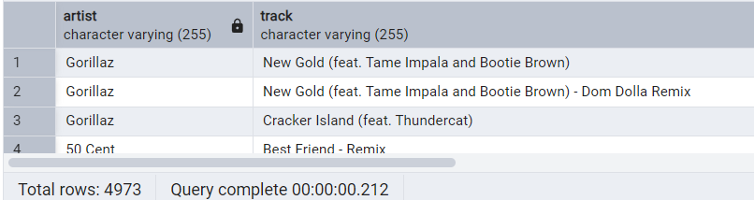

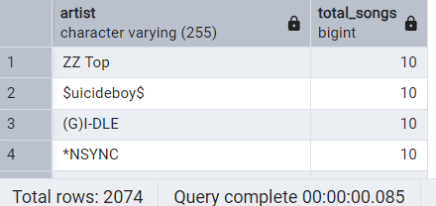
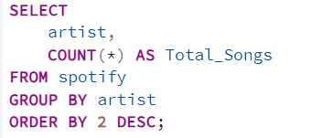
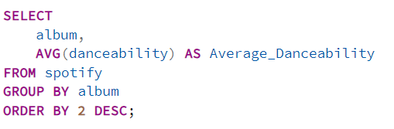
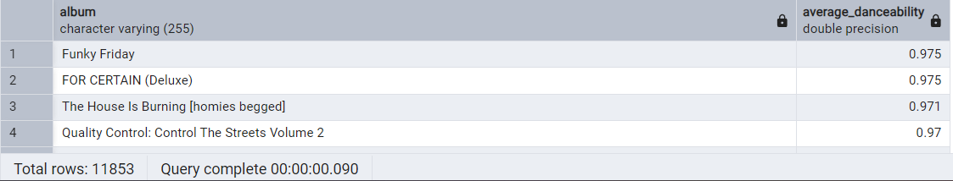
QUERIES
4. Find all tracks that belong to the album type single.
5. Count the total number of tracks by each artist.
6. Calculate the average danceability of tracks in each album.

Slide 5
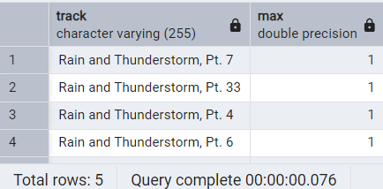
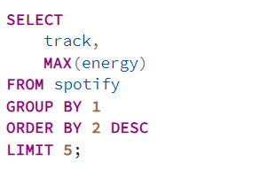
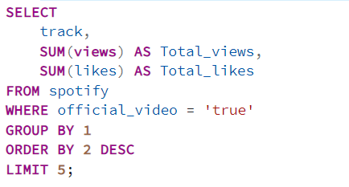
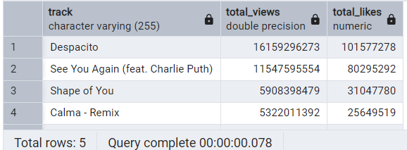
QUERIES
7. Find the top 5 tracks with the highest energy values.
8. List all tracks along with their views and likes where official video = TRUE.

Slide 6
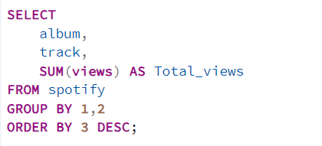
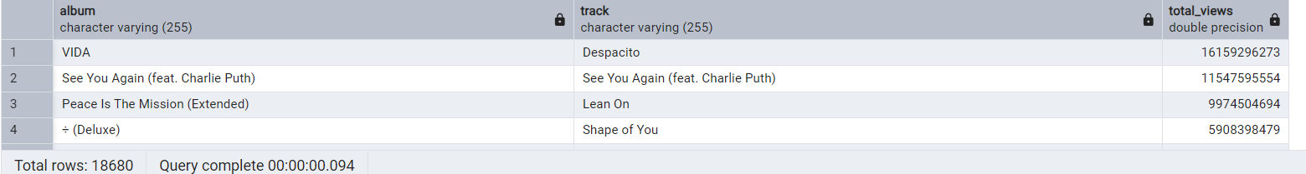
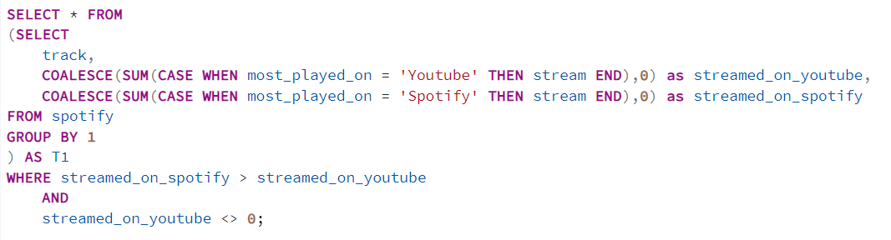
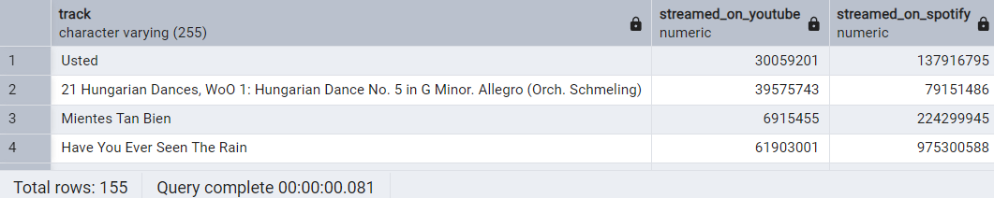
QUERIES
9. For each album, calculate the total views of all associated tracks.
10. Retrieves the track names that have been streamed on Spotify more than YouTube.

Slide 7
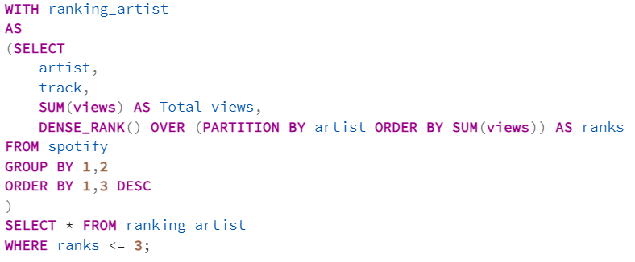
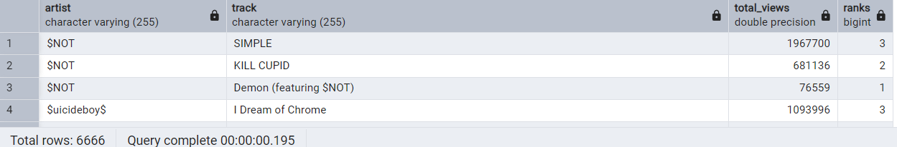
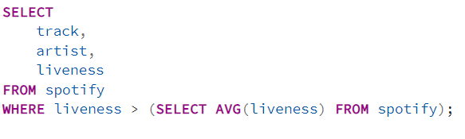
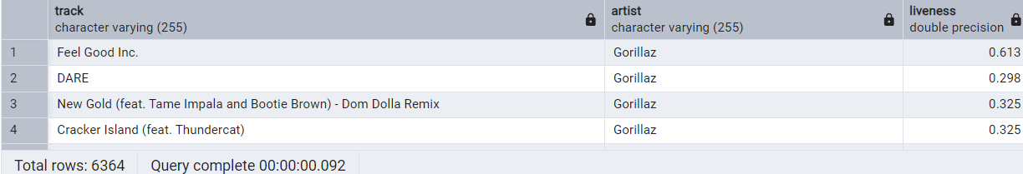
QUERIES
11. Find the top 3 most-viewed tracks for each artist using window functions.
12. Write a query to find tracks where the liveness score is above the average.

Slide 8
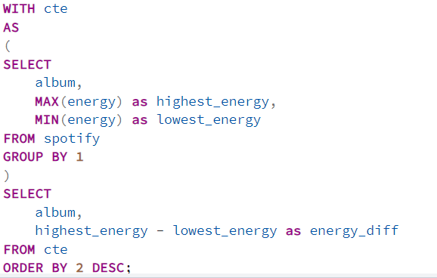
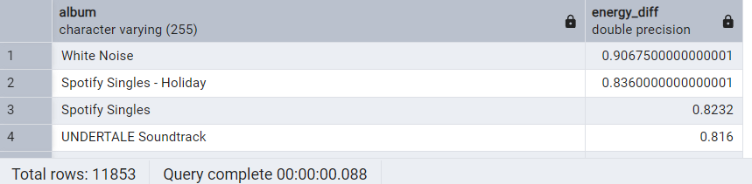
QUERIES
13.Use a WITH clause to calculate the difference between the highest and lowest energy values for tracks in each album.

Slide 9
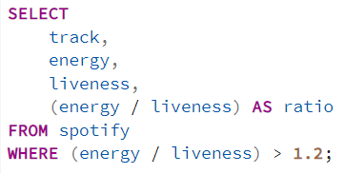
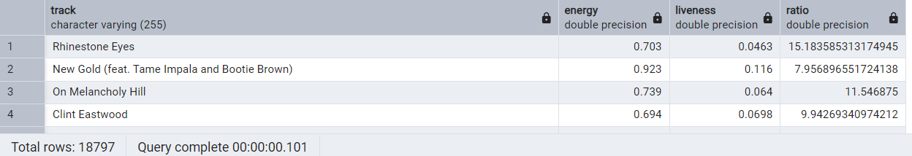
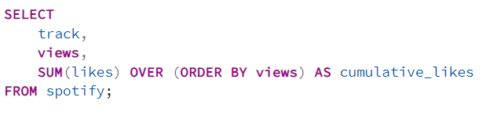
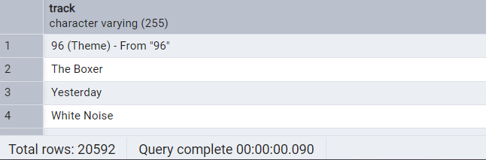
QUERIES
14. Find tracks where the energy-to-liveness ratio is greater than 1.2.
15. Calculate the cumulative sum of likes for tracks ordered by the number of views, using window functions.

Slide 10
Key Insights
🎵 Track Popularity & Streaming Trends
Only a few tracks exceed 1 billion streams, showing dominance by top artists.
Spotify vs. YouTube analysis helps identify audience preferences.
👤 Artist & Album Insights
Singles dominate the most-streamed tracks.
Some artists have many tracks, but only a few achieve massive success.
📊 User Engagement (Views, Likes, Comments)
Official videos get higher views & likes, boosting engagement.
Licensed tracks have more comments, indicating strong fan interaction.
🔥 Song Characteristics & Preferences
High-energy & danceable tracks are more popular.
Liveness score helps identify live-performance-like tracks.
By Vaibhav Bari

